Slide 1
Hotel Booking DMML project
From: Ankita Sengar (2022PITP301)

Slide 2
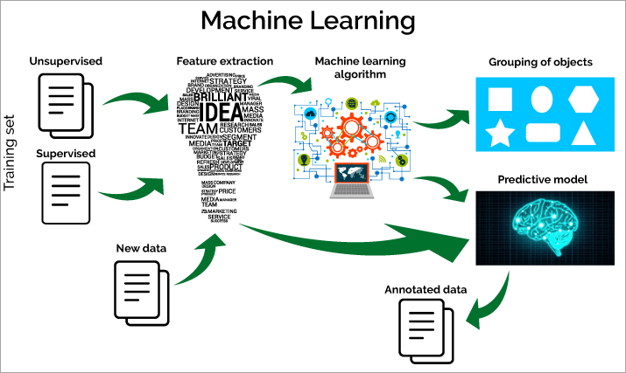
Data Mining and Machine Learning
Data mining is designed to extract the rules from large quantities of data, while machine learning teaches a computer how to learn and comprehend the given parameters

Slide 3
Why??
Association Rule Learning
Correlation Analysis
Outlier Detection
Classification and Regression
Data details: 1lakh 20 thousand unstructured clear data
Class 0: booking cancelled 1: booking complete

Slide 4
Hotel- Booking EDA
Where do the guests come from?
How much do guests pay for a room per night?
How does the price per night vary over the year?
Which are the most busy month?
How long do people stay at the hotels?
How many bookings were canceled?

Slide 5
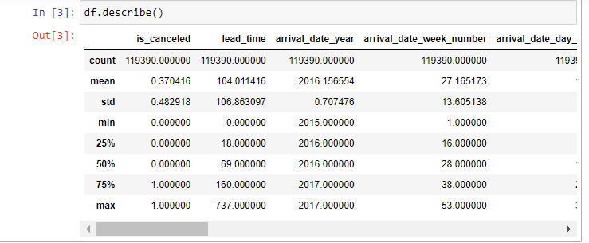

Data Distribution and Dispersion
Out[4]:
(119390, 32)
Out[4]:
(119390, 32)
Shape of data: (119390,32)
Categorical data: 12
Numeric data: 20
Null values: company(112593), Country(488), agent(16340)

Slide 6
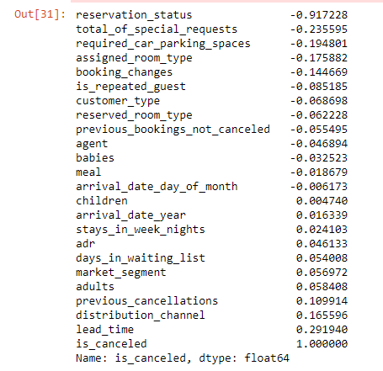
Checking Correlation Before Dropping: (118902,22)
118902, 22)
Adults, babies and children cant be zero at same time, so dropping the rows having all these zero at same time
180 such rows: new shape; 119210
As company is too sparse
Country can be filled with 0, as less than 13% missing
Drop less correlated columns ('days_in_waiting_list', 'arrival_date_year', 'arrival_date_year', 'assigned_room_type', 'booking_changes', 'reservation_status', 'country', 'days_in_waiting_list)

Slide 7
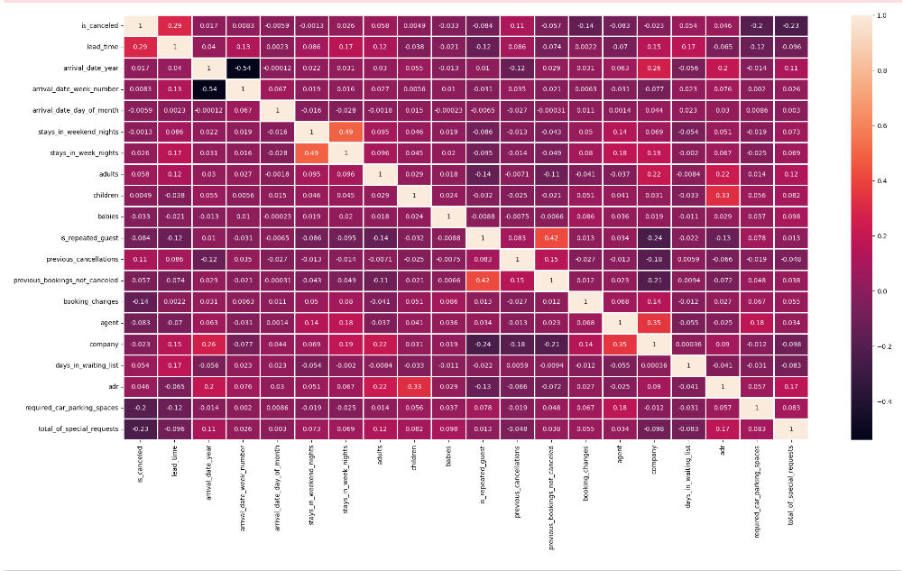
Heat Map

Slide 8
Questions like
Separte people who came in May
may_confirm = df_cln.loc[(df_cln["arrival_date_month"] == "May") & (df_cln["is_canceled"] == 0)]
7103 such people
To know the acutal visitor numbers, only bookings that were not canceled are included. And city hotel vs resort hotel.
46084 city hotel
28927 resort hotel

Slide 9
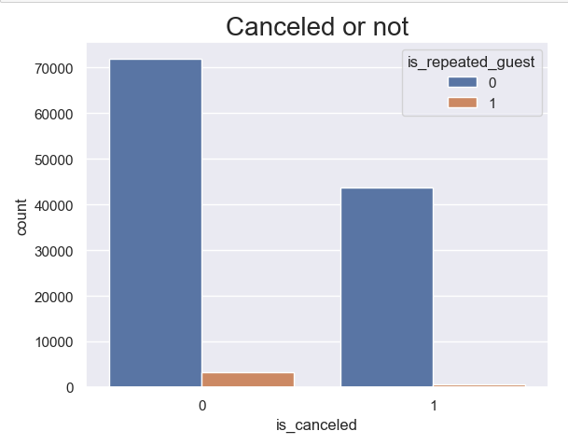
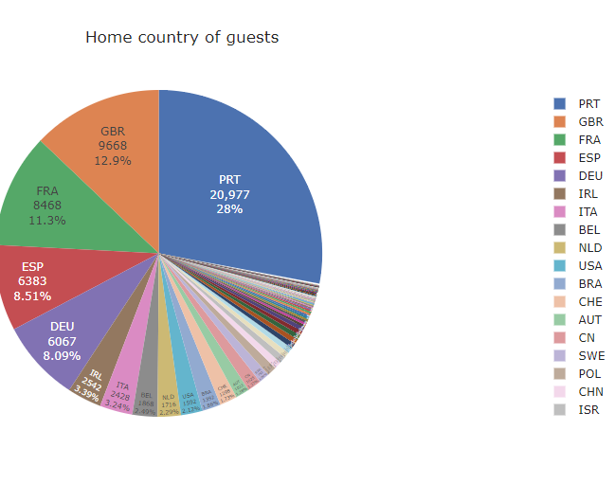
Graphical Analysis
Cancellations by repeated guests
Number of guests by country

Slide 10
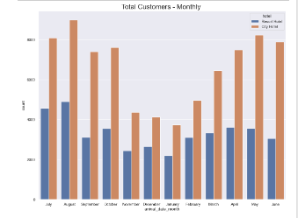
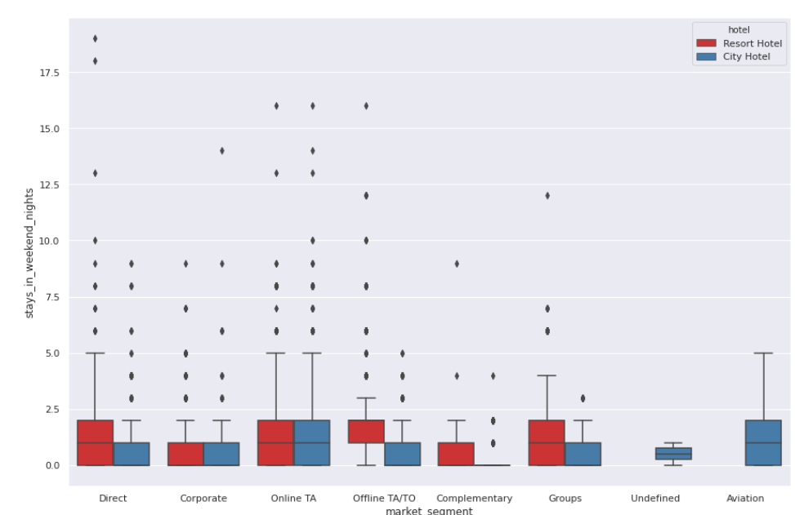
continue
Nights Spent at Hotels by Market Segment and Hotel Type
Monthly Customer

Slide 11
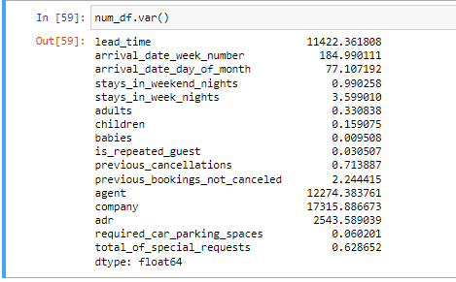
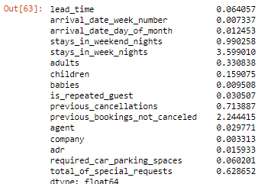
Numeric Vs Categorical
Numeric Value: 16 Columns
Numeric Value: Normalization

Slide 12
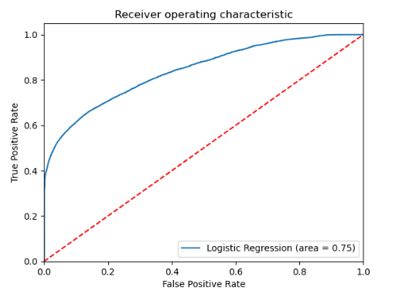
Models(Acc,Precision,Recall)
Naïve Bayes:(82,91,27)
Logistic Regression: (80,78,94)

Slide 13
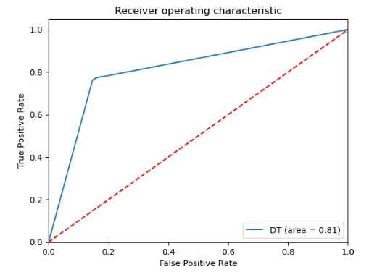
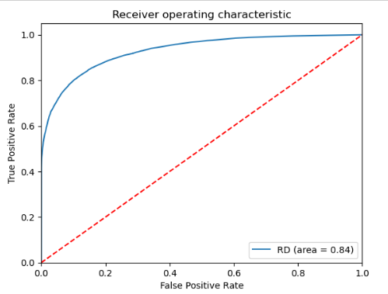
Models(Acc,Precision,Recall)
Decision Tree(81,92,25)
Random Forest: (86,78,94)

Slide 14
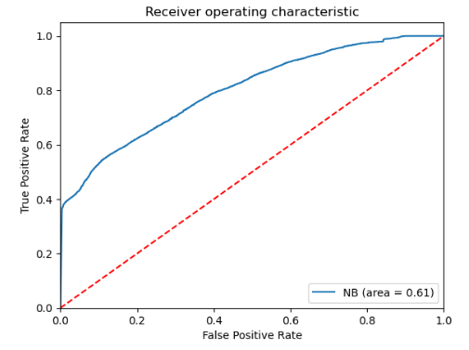
Models(Acc,Precision,Recall)
KNN:(81, 83,88)
SVM: (80,78,94)

Slide 15
THE END

